Slide 1



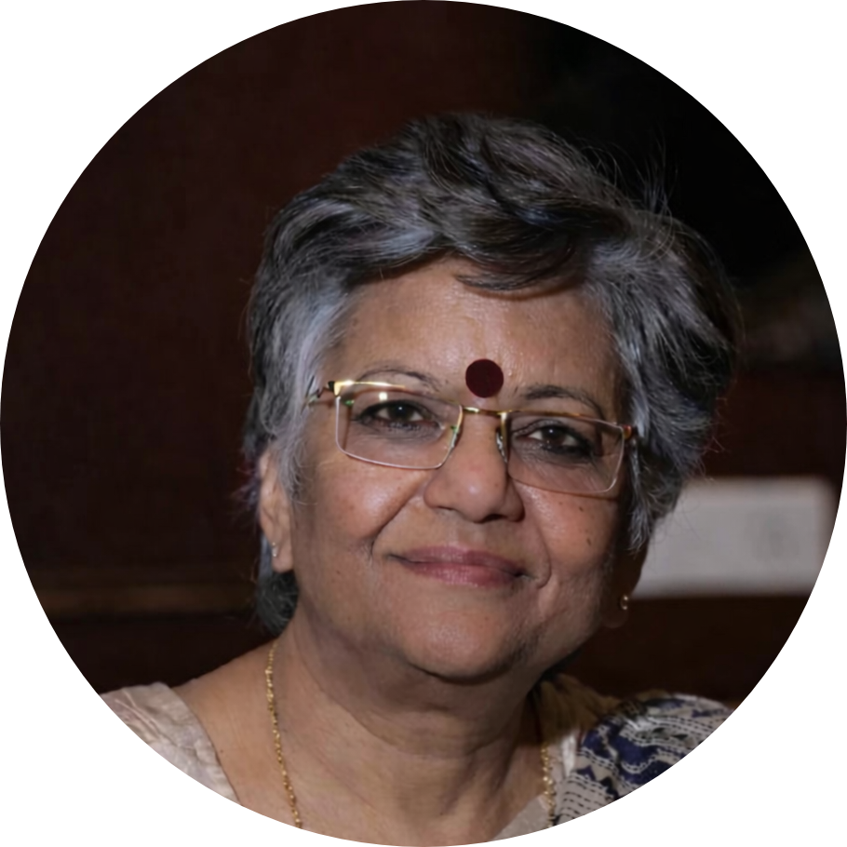
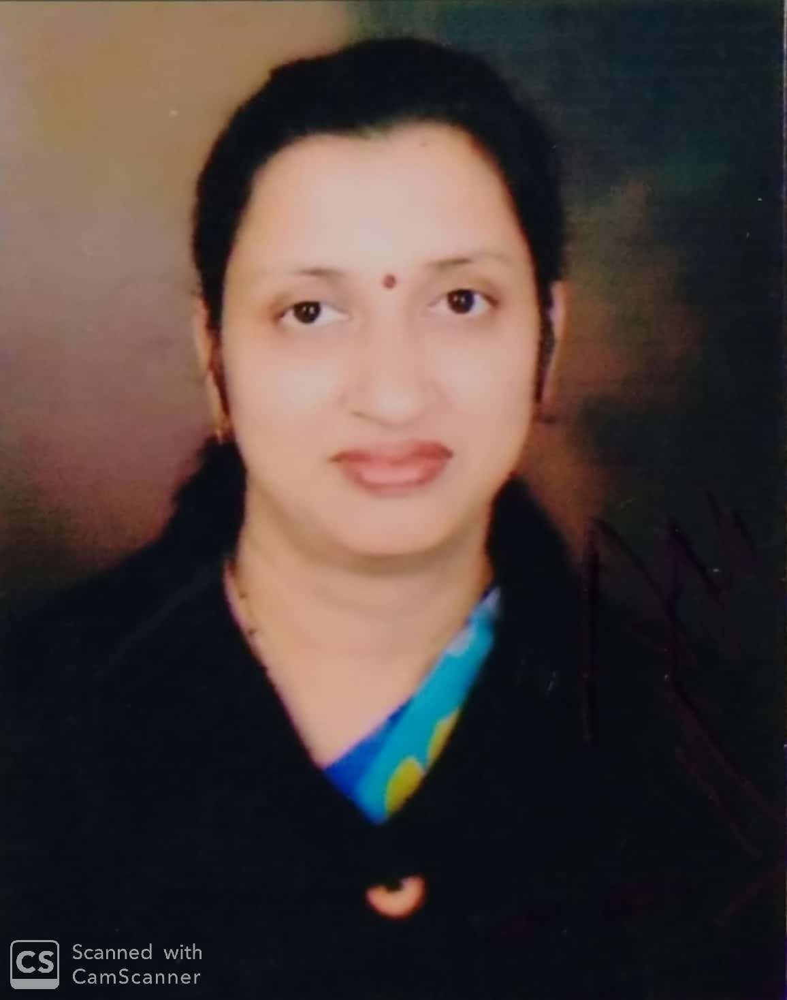
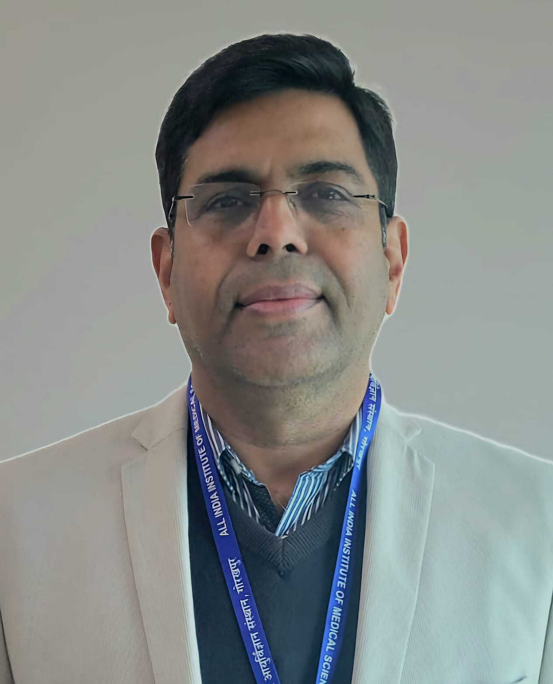
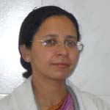
Hands-on Workshop on “Gene Expression Analysis using Real-Time PCR (RT-PCR)”
Multidisciplinary Research Unit, AIIMS Gorakhpur
in collaboration with
Department of Health Research, MoHFW- Govt. of India.
Objective: This hands-on training program aims to strengthen research capacity by providing practical training in core molecular biology techniques, including RNA isolation, cDNA synthesis, RT-PCR/qPCR experimentation, and molecular data analysis. The program integrates theory with hands-on laboratory sessions and interactive discussions.
Program Outline
Role of Molecular Biology in Health & Disease management.
Technical overview of Real-Time PCR.
Principles of gene expression analysis.
RT-PCR data analysis and interpretation.
Common troubleshooting strategies.
Takeaways
Practical understanding of core molecular biology techniques.
Application of molecular biology in health and disease management.
Improved experimental accuracy and troubleshooting skills.
Enhanced research readiness and confidence.
Co-Patron
Prof (Dr.) Mahima Mittal
Dean Academics,
AIIMS Gorakhpur
Co-Patron
Prof. (Dr.) Anand Mohan Dixit
Dean Research , Nodal officer MRU, AIIMS Gorakhpur
Co-Patron
Prof. (Dr.) Shikha Seth
Dean Student Welfare,LRAC Member MRU, AIIMS Gorakhpur
Chief patron
Maj. Gen (Dr) Vibha Dutta, SM (Retd) Executive Director and CEO,
AIIMS, Gorakhpur
This workshop is organized by Multidisciplinary Research Unit, AIIMS Gorakhpur and
supported by Department of Health Research, MoHFW- Govt. of India.
Date : 13-14 March 2026
Time : 09:00 AM to 05:00 PM
Venue : Seminar Hall, Multidisciplinary Research Unit (MRU), AIIMS Gorakhpur
Contact Email: mruresearchaiimsgkp1@gmail.com

