Slide 1


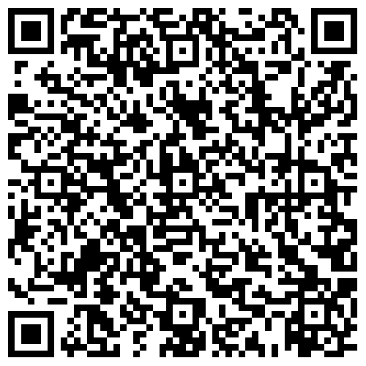
Hands-on Workshop on Gene Expression Analysis using Real-Time PCR (RT-PCR) March 13-14, 2026
Multidisciplinary Research Unit, AIIMS Gorakhpur
in collaboration with
Department of Health Research, MoHFW- Govt. of India
Objective: This hands-on training program aims to strengthen research capacity by providing practical training in core molecular biology techniques, including RNA isolation, cDNA synthesis, RT-PCR/qPCR experimentation, and molecular data analysis. The program integrates theory with hands-on laboratory sessions and interactive discussions.
Lectures:
Role of Molecular Biology in Health & Disease management.
Technical overview of Real-Time PCR
Principles of gene expression analysis.
RT-PCR data analysis and interpretation.
Common troubleshooting strategies.
Who can Participate:
The training program is intended for BSc/MSc/MBBS/MD/MS/MDS/PhD scholars, and research staff involved or interested in molecular biology research. The number of participants is limited, and selection will be made on the basis of relevant research interests.
Maximum Number of Seats: 25 Participants.
For Registration:
Duly fill the registration form through google link attached with this invitation. Selected participants will be intimated through mail on 9th March 2025. There is no registration fees for this workshop.
Hands on Experiment:
RNA isolation from biological samples.
RNA quality check by agarose gel electrophoresis
RNA quantification by spectrophotometry (Nanodrop).
cDNA synthesis.
Real-Time PCR setup and amplification.
Data analysis and interpretation of results.
Link: https://forms.gle/puo6yALDFcMjoztr8
Dr. Shailendra Dwivedi
Organizing Secretory
Associate Professor, Department of Biochemistry, AIIMS, Gorakhpur
Dr. Anand Mohan Dixit
Organizing Chairperson
Dean Research/Nodal Officer, MRU, AIIMS, Gorakhpur
Organizing Co-Secretory
Dr. Atul Rukadikar, AIIMS Gorakhpur
Dr. Saurabh Kedia, AIIMS Gorakhpur
Dr. Mohan Raj PS, AIIMS Gorakhpur
Dr. Charushila Rukadikar
Resource Person
Dr. Abhishek Mishra, University of Arkansas for Medical Sciences (UAMS), USA
Dr. Shailendra Dwivedi, AIIMS Gorakhpur
Dr. Mohan Raj PS, AIIMS Gorakhpur
Important Dates:
Start of registration: 26 February 2026
Last date of registration: 8 March 2026
Intimation of selected participants: 9 March 2026
Commencement of the Workshop: 13 March 2026
Reach us:
mruresearchaiimsgkp1@gmail.com
Mob No: +91-7007198836

