Slide 1


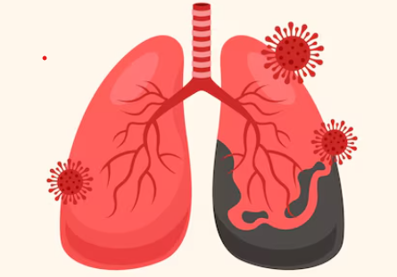

ALL INDIA INSTITUTE OF MEDICAL SCIENCES
GORAKHPUR
THEME: Yes! We Can End TB: Commit, Led by Countries. Powered by people
WORLD TB DAY C.M.E.
2:30 PM - 4:50 PM | 24.03.2026
Venue: Seminar Hall Auditorium
24
PROGRAMME SCHEDULE
Time | Topics | Speakers
02:00 – 02.15 PM | Registration
02.15-02.20 PM | Welcome Address | Dr. Subodh Kumar Pandey Professor & Head, Pulmonary Medicine
02.20 -02.30 PM | Inauguration | Maj Gen (Dr.) Vibha Dutta, SM (Retd.) Executive Director and CEO, AIIMS Gorakhpur
02.40 – 03:00 PM | Current Scenario of Tuberculosis in India | Dr. Rama Shankar Rath Associate Professor, Community Medicine
03:00– 03:20 PM | Advances in TB Diagnosis | Dr. Aroop Mohanty Associate Professor, Microbiology
03.20 -03.40 PM | Complications of Pulmonary Tuberculosis | Dr. Kanupriya, DM Resident, Pulmonary Medicine
03.40 – 04:00 PM | Pulmonary Rehabilitation | Dr. Abhimanyu Vasudeva Associate Professor, PMR
04.00- 04.30 PM | Management of Drug-Resistant Tuberculosis | Lt.Col Shafin Babu PS, Associate Professor, Army Hospital (Research and Referral), New Delhi
04:30-04.35 PM | Vote of Thanks | Dr. Kanupriya, DM Resident, Pulmonary Medicine
04.35 PM onwards | High Tea and Snacks | Multi Purpose Hall
The theme of World TB Day 2026 - "Yes! We can end TB! Led by countries, powered by people".
This theme emphasizes the need for strong national leadership, increased investments, and active community involvement to achieve the global goal of ending the tuberculosis epidemic.

