Slide 1




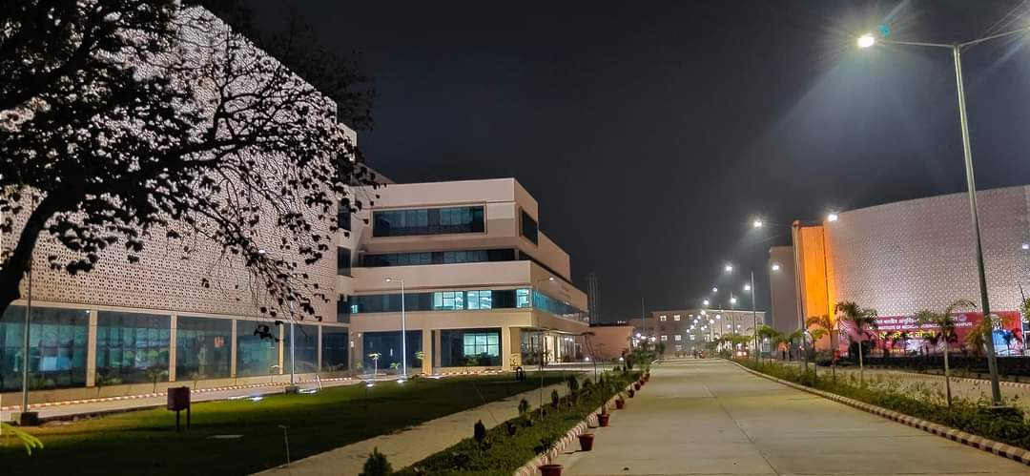

3rd Annual Conference of Cardio-Diabetic Society
All India Institute of Medical Sciences, Gorakhpur
Under the banner of
the Cardio-Diabetic Society
An International Conference on Cardio-diabetes
& Metabolic Disorders
“From care to cure”
19th -20th November 2022 | Venue: Auditorium at AIIMS, Gorakhpur
Register Now : www.accds.com

Slide 2
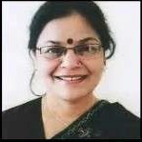
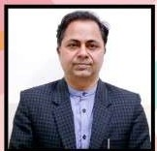
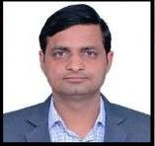

Message from Organisers
On behalf of the Cardio-Diabetic Society, we welcome you on board with us on 19th-20th November 2022 at the 3rd Annual International Conference of Cardio-Diabetic Society. This event will be organized at AIIMS Gorakhpur to have a lustful academic feast in Gorakhpur, a city in the Indian state of Uttar Pradesh, along the banks of the Rapti river in the Purvanchal region adding a blissful flavor to it. We are sure that the forthcoming conference shall bring together academics of the highest level and updated diagnostic and management protocols in advances in Diabetology and Cardiology. Academicians par excellence from India and abroad shall be present as faculty and share their ideas in the said fields. The conference will be organized in physical as well as the virtual mode to enhance participation and enrich the delegated with inputs from every nook and corner.
Hope to see you soon at AIIMS, Gorakhpur
Prof. (Dr.) Surekha Kishore
Executive Director,
AIIMS, Gorakhpur
Dr. Ravi Kant
President
Cardio-Diabetic Society
Dr. Barun Kumar
Secretary
Cardio-Diabetic Society
About Cardio Diabetic Society
The cardio-diabetic society is committed for it scientific contribution in the field of Cardiology and Diabetology, the deadly duo, globally in general and Asian countries in particular.
The society is under the patronage of top academicians and educationists. The current patron of society Prof. Surekha Kishore has been the Dean (Academics) AIIMS Rishikesh and currently is the Executive Director and CEO of All India Institute of Medical Sciences, Gorakhpur India.
Co-patron Prof. Ashok Kumar is currently serving as additional Medical superintendent at Post Graduate Institute of Medical Education and Research (PGIMER) Chandigarh, India. The society is functioning under young dynamic leadership of Dr.Ravi Kant, Additional Professor and Head, Division of Diabetes and Metabolism at AIIMS Rishikesh ,a renowned diabetologist as President and Dr. Barun Kumar, Associate Professor Cardiology at AIIMS Rishikesh, Interventional Cardiologist as Secretary of the society. The society is relentlessly working for the preventive , promotive, curative and rehabilitative aspects of diabetes and cardiac diseases.

